Slide 1
Sequential Circuits II
Registers
CSE 4205: Digital Logic Design
Aashnan Rahman
Junior Lecturer
Department of Computer Science and Engineering (CSE)
Islamic University of Technology

Slide 2
01
Registers

Slide 3
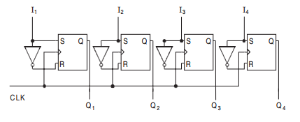
Introduction
A group of binary cells that can hold binary information
  Normally, a group of flip flops makes a register
    n bit register has n flip flops to hold n bits of information
A register may have an additional combinational circuit that performs data processing task

Slide 4
Basics of a Register
Registers are considered as MSI
All the flip flop has a common clock pulse to enable at the same instant
  Generally, negative edge triggered or master-slave type flip flop are used
  These kinds of flip flops are called gated latch which have third input to activate them
Registers could be designed with S-R, J-K and D flip flops
  T flip-flop is not preferred here.

Slide 5
02
Shift Register

Slide 6
Shift Register Classification
Direction of shifting
  It is capable of shifting its binary contents either to the right or to the left
    Right Shift
    Left Shift
Types of shifting
  Serial shifting
    Shift one bit at a time for each clock pulse in a serial manner starting with LSB or MSB
  Parallel shifting
    All the data bits shift simultaneously during a single clock pulse
    Quicker than serial shifting operation

Slide 7
Shift Register Classification
Unidirectional Shift Register
  Transfer data in only one direction (Left or Right)
Bidirectional Shift Register
  Transfer data in both right and left direction
Universal Shift Register
  Transfer data in both right and left direction along with the necessary input and output terminals for parallel transfer

Slide 8
03
Basic Types of Registers

Slide 9
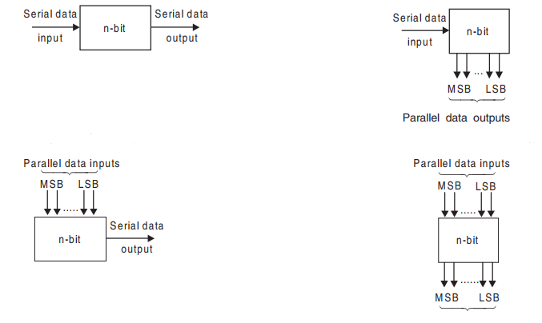
Shift Register: Basic Types
SISO (IC 74L91)
SIPO (IC 74164)
PISO (IC 74265)
PIPO (IC 74198)

Slide 10
3.1
SISO

Slide 11
Shift Register: SISO
Input data – serially through a single input line
Output data – also serially through a single output line
  Note: If a new data bit is inserted into register from one end, on the other end, previously stored data bit will be shifted out
    Very similar to the concept of “queue”
Types based on direction of shifting
  Left shift register
    Data shifts from right to left
  Right shift register
    Data shifts from left to right

Slide 12
Shift Register: SISO
Clock pulse is applied to all flip flops simultaneously
If we want to get complete data available in register, we have to wait until n^{th} clock cycle for n bit register
  To get the last inserted bit as output from the last flip flop (Q_{n}), we need to wait (n-1) clock cycles more
    In total (2n-1) clock cycles to achieve full data as output serially
    In the mean time, the register will be reset with output 0

Slide 13
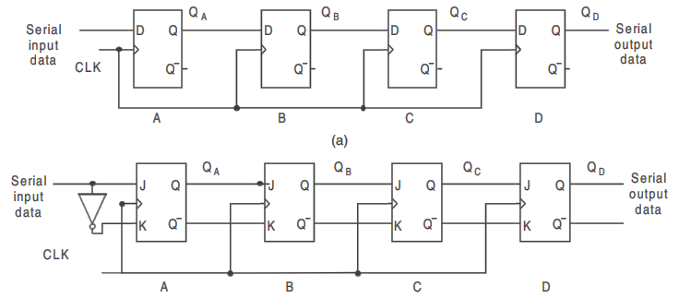
Shift Register: SISO (Right Shift)
Using D flip flop
MSB
LSB
Using JK flip flop

Slide 14
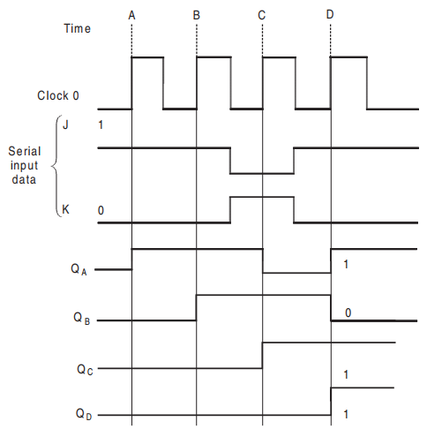
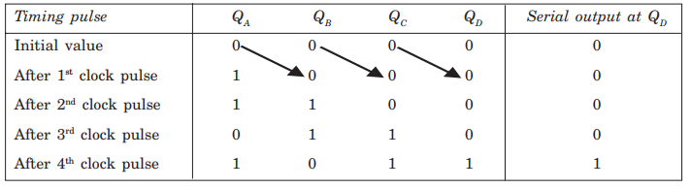
Shift Register: SISO (Right Shift)
Example with Data “1011”

Slide 15
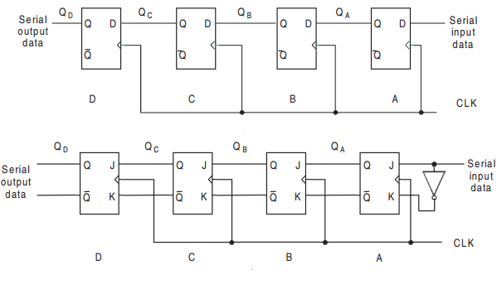
Shift Register: SISO (Left Shift)
Using D flip flop
LSB
MSB
Using JK flip flop

Slide 16
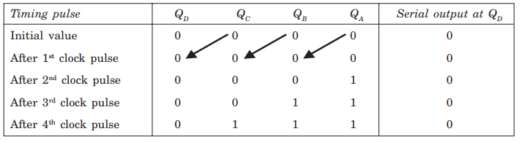
Shift Register: SISO (Left Shift)
Example with Data “1110”

Slide 17
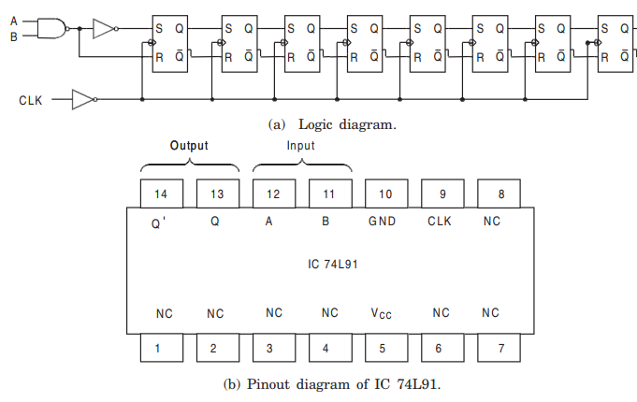
Shift Register: 8 bit SISO Register IC

Slide 18
3.2
SIPO

Slide 19
Shift Register: SIPO
Property: Data is shifted serially, but shifted out in parallel
  All the outputs should be available at the same time by connecting the output of each flip flop to an output pin
  If the data is stored in the flip flops, instantly they are available in the output
Flop flops should be edge triggered or master slave flip flop to avoid any kind of glitch
Note: Clear input could be applied to reset all flip flops
During inserting (input) data hold and set-up time should be maintained

Slide 20
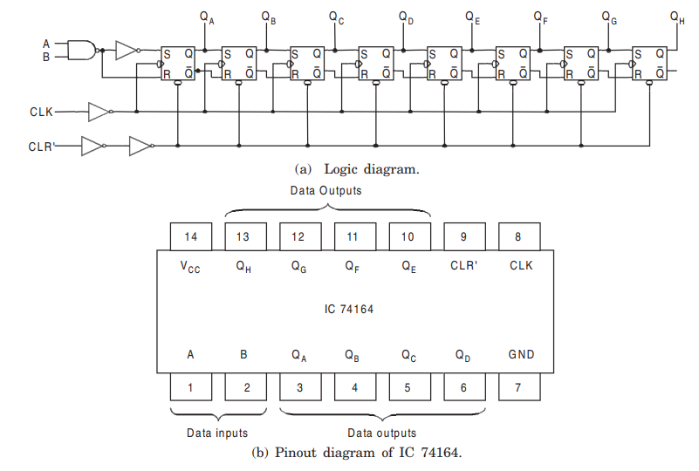
Shift Register: 8 bit SIPO Register IC

Slide 21
3.3
PISO

Slide 22
Shift Register: PISO
Property: Data is entered in parallel manner into the register
A control input (Shift/Load) is required to allow the all input data bits either to enter into the register in parallel or to shift the data in serial
  Shift signal enables the gates to allow the data bits to shift right or left
  Load signal enables the other gates to allow the data bits at the parallel inputs to be entered

Slide 23
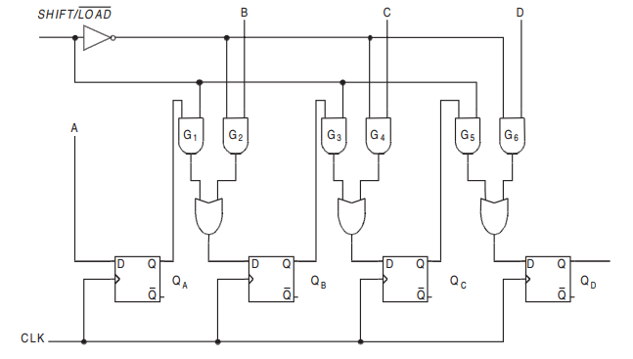
Shift Register: PISO

Slide 24
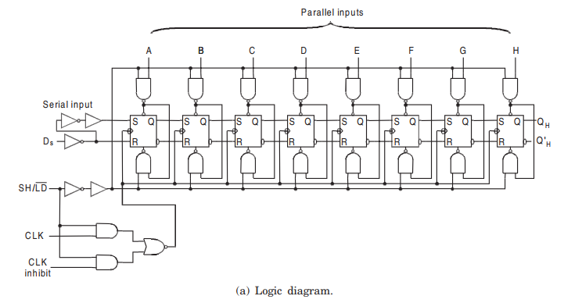
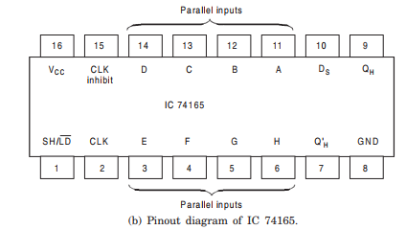
Shift Register: 8 bit PISO Register IC

Slide 25
3.4
PIPO

Slide 26
Shift Register: PIPO
Property: Data can be shifted into or out of the register in parallel
No interconnection between the flip flops as no serial shift is required
When the data entry is accomplished at the parallel inputs, that data will be available at the parallel outputs instantly
  An application of active clock pulse is required to perform this task as well
More pins are required in the IC to accommodate all inputs and outputs

Slide 27
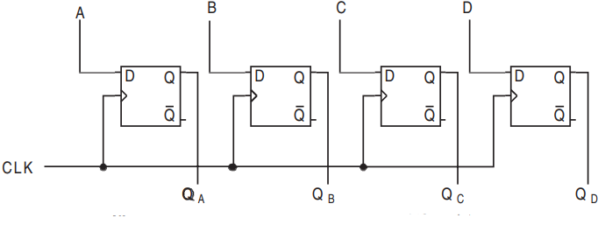
Shift Register: PIPO

Slide 28
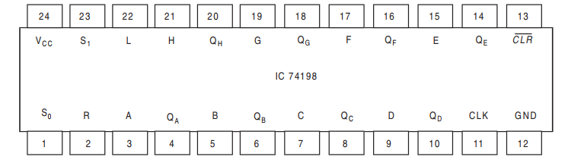
Shift Register: 8 bit PIPO Register IC

Slide 29
04
Bidirectional Shift Register

Slide 30
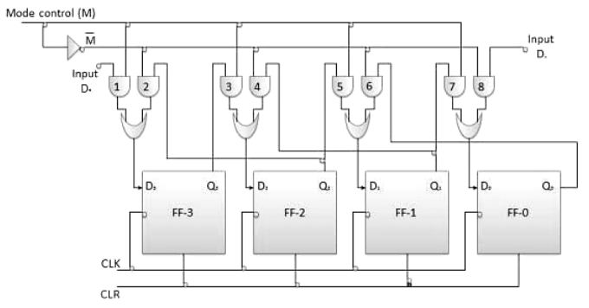
Bidirectional Shift Register

Slide 31
05
Universal Register

Slide 32
Universal Register
Right or Left shift control input
  To enable the shift operation in a particular direction
Parallel load control
  To enable a parallel transfer with n parallel input or output lines
Clear input
  To reset the register
Another control input also can be applied to keep the data in the register unchanged

Slide 33
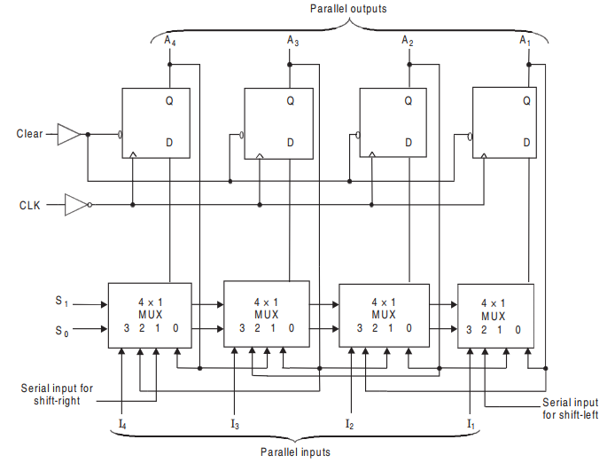
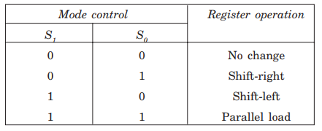
4 bit Universal Register

Slide 34
Thank You !!
Feel free to ask any questions

